Slide 1
Northeastern University
Software QA & Testing
Fundamental of Testing
Fall 2019

Slide 2
Medi Servat
INFO6255
m.servattalab@northeastern.edu

Slide 3
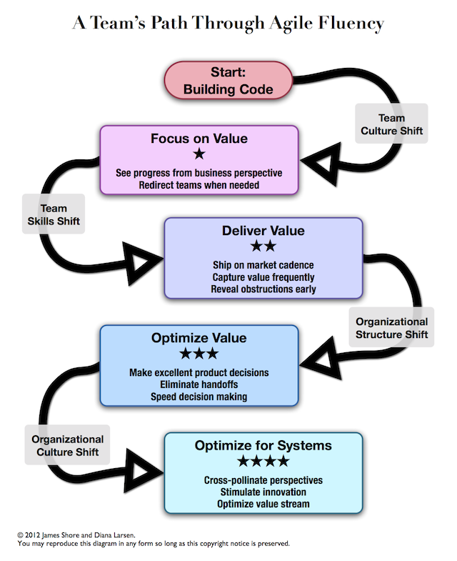
Agile Development
Adaptive rather than predictive
People oriented than process oriented
Project is divided into milestones
Minimum viable product (MVP)
Scrum teams
Milestones have sprints
Each sprint has multiple stories
Stories are the deveralibles

Slide 4
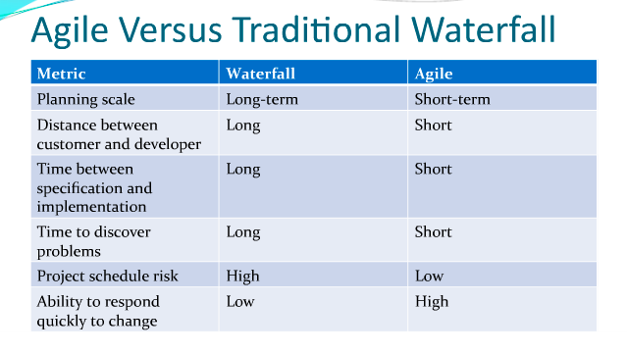
Agile vs. Waterfall
https://www.venveo.com/blog/agile-vs-waterfall-project-management

Slide 5
Automated Testing in Agile World
Each sprint adds new feature and refactoring as the design might evolve
Previous code should continue to work
Automated testing framework provides the firepower for this continuous development
Automated tests are added incrementally and developing a prefect testing framework is not the intention at the start
Meaningful tests add more value than automated everything

Slide 6
Principles behind the Agile Manifesto
We follow these 12 principles:
Our highest priority is to satisfy the customer through early and continuous delivery of valuable software.
Welcome changing requirements, even late in development. Agile processes harness change for the customer's competitive advantage.
Deliver working software frequently, from a couple of weeks to a couple of months, with a preference to the shorter timescale.
Business people and developers must work together daily throughout the project.
https://martinfowler.com/agile.html

Slide 7
Principles behind the Agile Manifesto (Continued)
Build projects around motivated individuals. Give them the environment and support they need, and trust them to get the job done.
The most efficient and effective method of conveying information to and within a development team is face-to-face conversation.
Working software is the primary measure of progress.
Agile processes promote sustainable development. The sponsors, developers, and users should be able to maintain a constant pace indefinitely.
https://martinfowler.com/agile.html

Slide 8
Principles behind the Agile Manifesto (Continued)
Continuous attention to technical excellence and good design enhances agility
Simplicity--the art of maximizing the amount of work not done--is essential.
The best architectures, requirements, and designs emerge from self-organizing teams.
At regular intervals, the team reflects on how to become more effective, then tunes and adjusts its behavior accordingly
https://martinfowler.com/agile.html

Slide 9


Agile – Scrum Framework
There are several Agile Frameworks: Scrum, Kanban, XP and Others
Scrum: A framework within which people can address complex adaptive problems, while productively and creatively delivering products of the highest possible value.
Scrum is lightweight and simple to understand.
Scrum emphasizes self-organizing, cross functional teams.
Scrum does not prescribe any technical practices, rather it emphasizes management practice such as the role of Scrum master.

Slide 10
More on Scrum Factors and Core Team values
3 Important Factors of Scrum:
Transparency of the Process
Frequent Inspection of the Artifacts
Adaptation, or making adjustments after inspection
Core Team Values of Scrum
Team Commitment to meet the goals
Value Focus to deliver better quality, faster
Openness with the team members to adapt better
Respect the team to allow them voicing concerns
Value Courage to allow greater challenge

Slide 11

Scrum Roles
Here are the Scrum roles
Product Owner
Scrum Master
“The Team”
QA
Developers
BSA

Slide 12
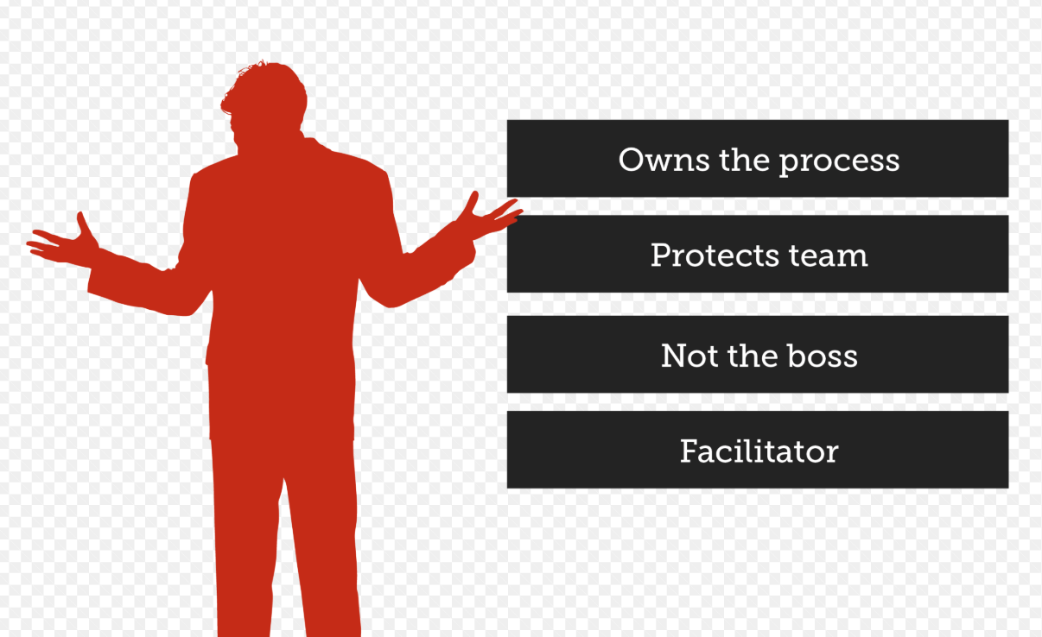
Scrum Master
The Scrum Master is responsible for the project’s success
Role of the Scrum Master
Represent management and the project
Responsible for enacting Scrum values and practices
Remove impediments
Ensure that the team is productive
Enable close cooperation across all roles and functions
Shield the team for external influences
Is a Servant Leader

Slide 13

Scrum Master
Does not own the product decisions on product owner’s behalf
Does not Make estimates on team’s behalf
Does not Make technology decisions' on team’s behalf
Does not Assign the tasks to the team members
Does not manage the team

Slide 14


Servant Leadership
What is a Servant Leadership?
Change from a traditional leadership (workers need to be monitored closely)
It is based on trust (the team members to be self-motivated)
The Servant Leader
Protects the team from outside distractions
Removes impediments
Facilitates the team to address the tasks and resolve problems
Removes obstacles that would prevent the team providing business values

Slide 15
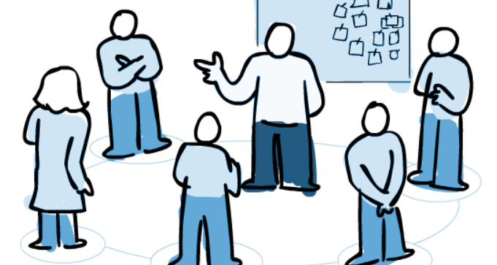
Daily Scrums
Scrum is a framework within which people can address complex adaptive problems, while productively and creatively delivering products of highest possible value
The scrum meetings criteria:
Daily
Same Time
Same Place
Stand up
Everyone is invited, however only the
team members and the scrum master
can talk.
3 Questions:
What did you do yesterday?
What will you do today?
Is anything blocking you??

Slide 16
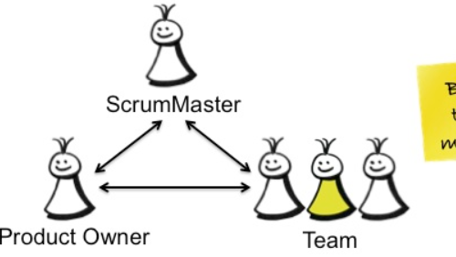
Product Owner
The Product owner is responsible for the product success
The Product Owner role is filled by one person who has a vested interest in the product:
Is the Subject Matter Expert (SME): Understands the domain well enough
End User and Customer advocate: Describes the product with understanding of the users and the functionality of the product
Business Advocate: Understands the needs of the organization for the product
Communicator: Capable of communicating vision and intent
Decision Maker: Be the final decision maker for hard product decisions

Slide 17
Product Owner Roles
Defines the features of the product
Decides on Release dates and contents
Is responsible for the Total Cost of Ownership and the Profitability of the Product
Orders features according to Market value
Adjusts features and priority every sprint as needed
Available daily to answer questions
Inspects product progress
Does not choose how much work will be accomplished in the Sprint
Does not change anything within the Sprint once it has started

Slide 18
The “Team”
The team’s Dos and Don’ts
Self organizing (Self empowered, Responsible with no individual egos)
Should include developers, testers, UI designers, etc.
Full Time (FTEs)
Should not change during Sprints
Should not skip meetings
Should not stop working when they hit roadblock

Slide 19
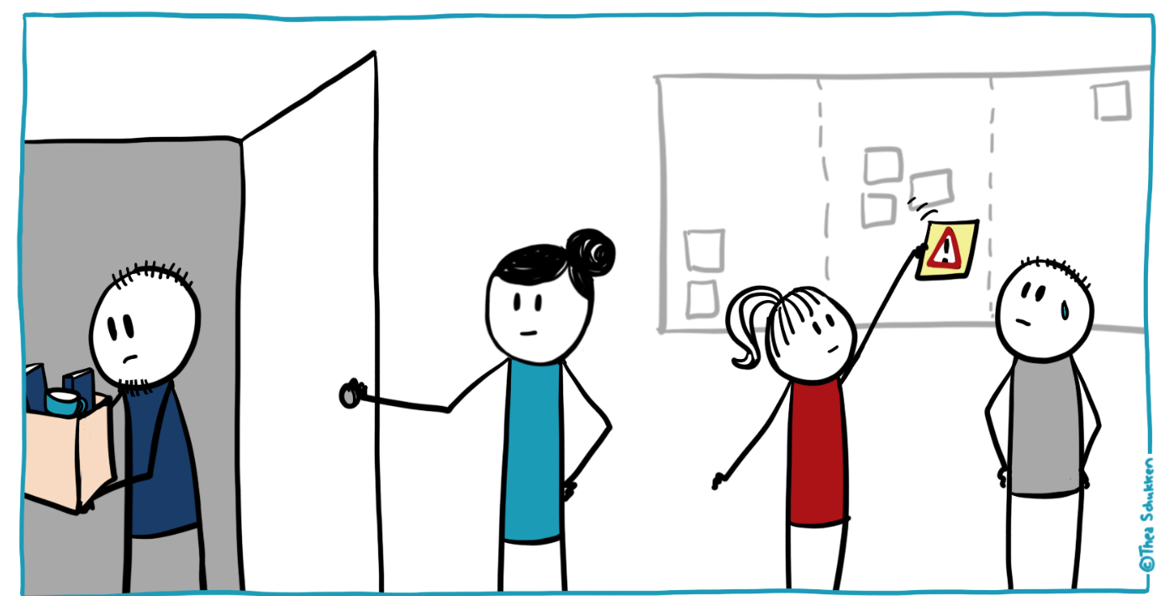



Agile Project Process (Events)
Daily 15 minute scrums, same time and same place
Involves creating requirements creation, prioritization and estimation. 10% of each Sprint.
Product Backlog = Wish List
Sprints are a max length on 1 month.
All work should be marked as DONE.
Occurs every Sprint.
Half Review and half design.
Pull a small chunk from the Sprint Backlog and decide how to develop.
Scrum
The DONE work is shown to the stakeholders.
Sprint
2-4 weeks
Refining backlog
Sprint planning
Working Software

Slide 20
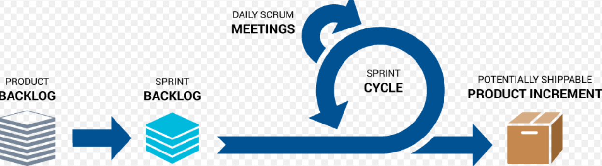
Sprints
Scrum
Sprint
Scrum projects progress via a series of Sprints
During a Sprint the Scrum team takes a small set of features from
Idea -> Coded -> Tested
At the end of the Sprint the team has gone through:
Idea -> Coded -> Tested -> Integrated -> Delivered
There should be No Changes during a Sprint

Slide 21
Sprint Durations, Pros and Cons
Four-Week Sprint:
Pros: easy to roadmap, low process load
Cons: Long turnaround and mini Waterfall
One Week Sprint:
Pros: Fast Turnaround, High Energy
Cons: Minimal customer feedback, Lack of a roadmap, Relatively heavy or no process.

Slide 22
The Scrum Events
Sprint Planning: 2 hours per week on Requirements & Design
Sprints: One Month Max
Daily Scrums: 15 minutes Daily
Backlog Refinement (grooming): 2 hours/week
Sprint Review: a couple of hours a week
Sprint Retrospectives: a few hours for a one month Sprint

Slide 23
Agile Terminology
Themes, Epics, User Stories and Tasks – a Hierarchy to create Requirements
Product Backlog – A list of desired work on the project
The Sprint Backlog – The Product Owner works with the Development team to select stories based on a Sprint goal
Burndown Charts – Tracks work remaining. Story Points vs. Days.
Sprint Burndown Chart – Show work remaining
Release Burndown Chart – Show work remaining for the entire release
Velocity – Rate of Progress.

Slide 24
Agile Planning
Product Vision – is key to success
Product Roadmap – shows progress toward strategy
Release Plan – Occurs once the vision and roadmap are complete
Sprint Plan – Sprint Planning
Daily Plan – Scrums
Minimum Viable Product:
The highest return on Investment.
To test an idea by exposing an early version to target users

Slide 25
References
https://martinfowler.com/agile.html
http://info.thoughtworks.com/rs/thoughtworks2/images/ebook-agile-software-testing.pdf?aliId=26951538
Https://Scrum.org
http://agilemanifesto.org
Agile product ownership in a nutshell

Slide 26

Problems with the Agile Implementation
It is difficult to change the culture of an organization
Waterfall is in place and is hard to change
Not many people like “Change”
Agile can be implemented via: Education, Execution and Continuous Improvement in any organization.

Slide 27
Assignment
Research on line and find one Success Story about how the Agile process changed the mindset and delivered a good quality product
-- OR --
Research on line and find one Failed Story about how the Agile process did not work in the organization and why it failed.

